Slide 1



Research Data Management (RDM): Introduction
Sammy Khagayi

Slide 2
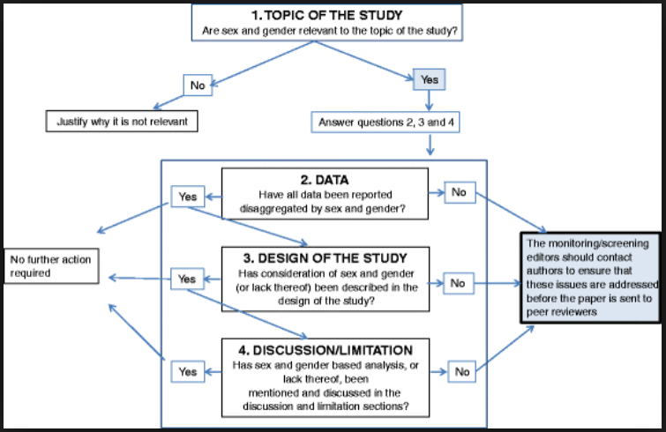
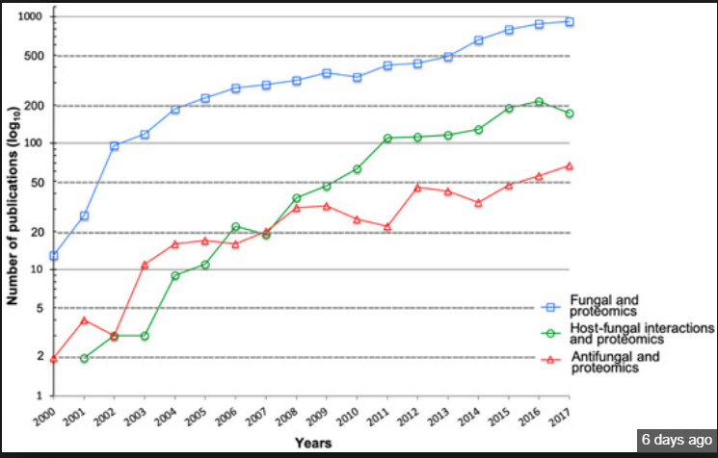
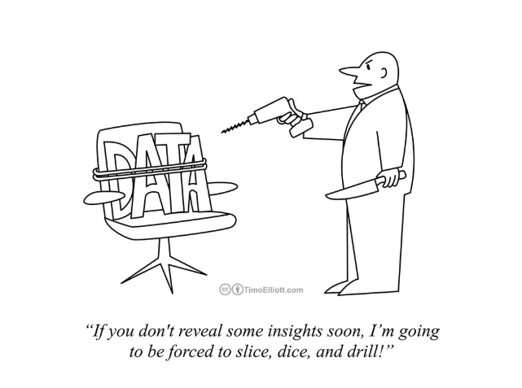

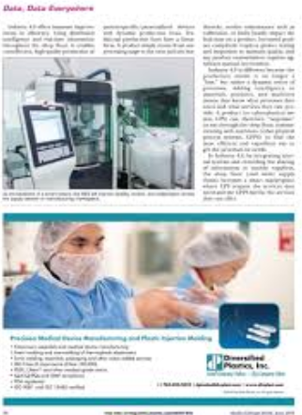
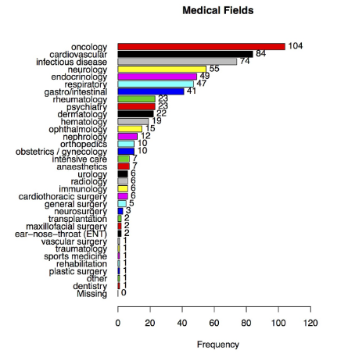
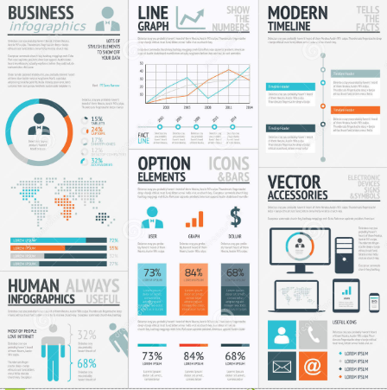
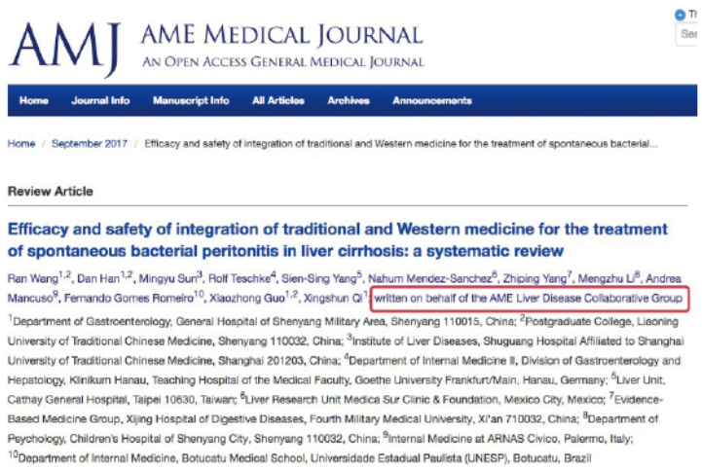
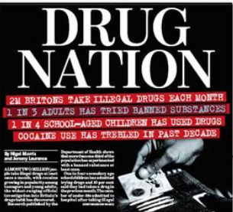
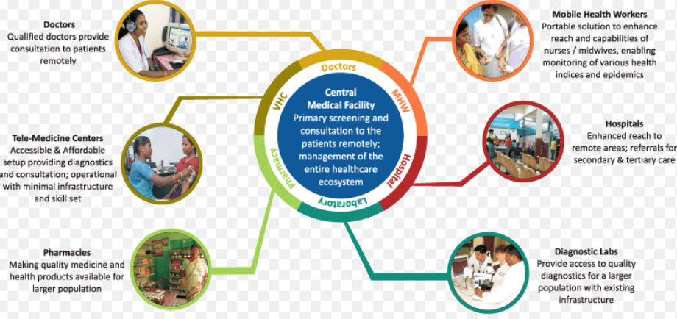
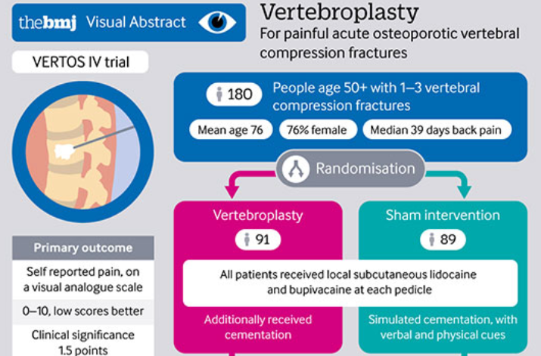

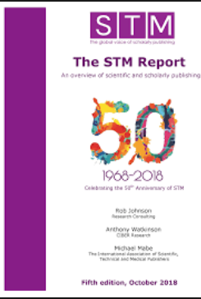
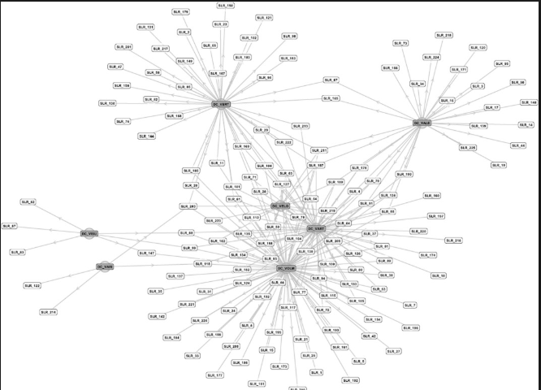
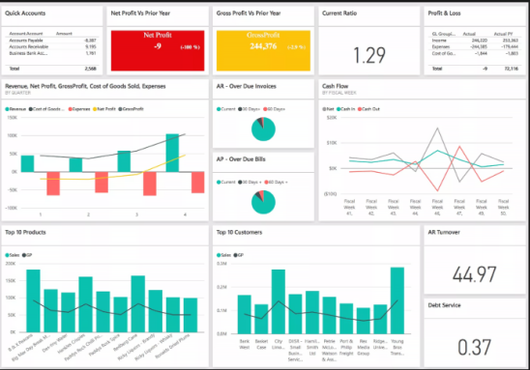
Data are everywhere!

Slide 3
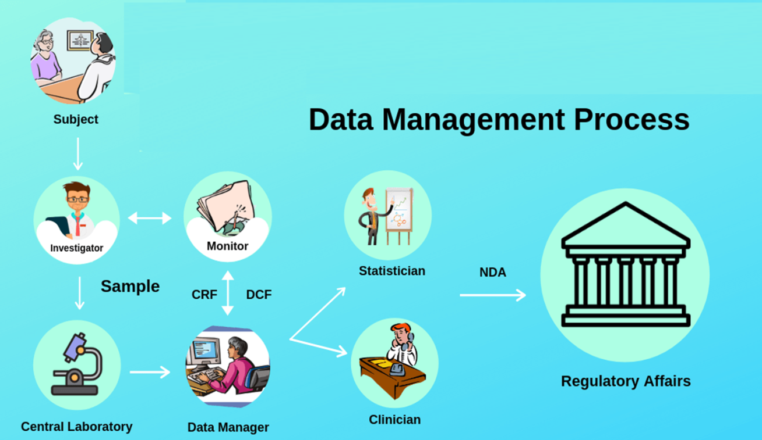
Data in relation to research!
Research data means: data in the form of facts, observations, images, computer program results, recordings, measurements or experiences on which an argument, theory, test or hypothesis, or another research output is based. Data may be numerical, descriptive, visual or tactile. It may be raw, cleaned or processed, and may be held in any format or media.

Slide 4
Data in relation to research!
Research data means: data in the form of facts, observations, images, computer program results, recordings, measurements or experiences on which an argument, theory, test or hypothesis, or another research output is based. Data may be numerical, descriptive, visual or tactile. It may be raw, cleaned or processed, and may be held in any format or media.
Research data is crucial as it is the evidence
base for your research findings

Slide 5
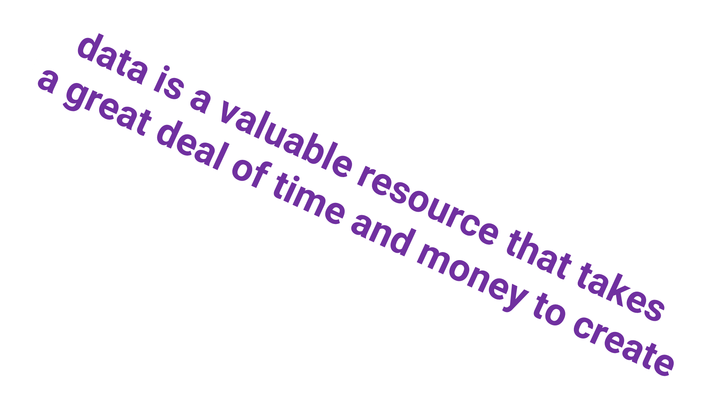
Data in relation to research!
Research data means: data in the form of facts, observations, images, computer program results, recordings, measurements or experiences on which an argument, theory, test or hypothesis, or another research output is based. Data may be numerical, descriptive, visual or tactile. It may be raw, cleaned or processed, and may be held in any format or media.
Research data is crucial as it is the evidence
base for your research findings

Slide 6
What is Research Data Management?
“Research Data Management (RDM) concerns the organisation of data;
From the start when data are collected through to the dissemination and archiving of valuable results.
It aims to ensure reliable verification of results, and permits new and innovative research built on existing information.
Research data management is part of the research process, aims to make the research process as efficient as possible and meet expectations and requirements of the institution(…), research funders, and legislation.”

Slide 7
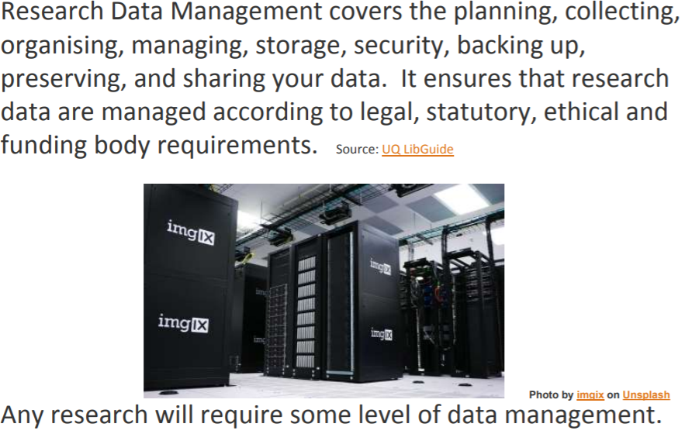


Slide 8

Disclaimer!
Research Data Management is not necessarily fun…

Slide 9

Disclaimer!
Research Data Management is not necessarily fun…
…but it is necessary!

Slide 10
Disclaimer!
Yes…:
…it takes time away from actual research you want to do;
…..instead,
it is necessary to take a step back and reflect on the things you are producing.
In short: boring chore of scholarly housekeeping and sometimes it might feel like it’s slowing you down.

Slide 11

Why research data management
Research integrity
What do the results lead to?
Are the results genuine?
Are research participants protected?
Ensures that research data are authentic, complete, and reliable

Slide 12
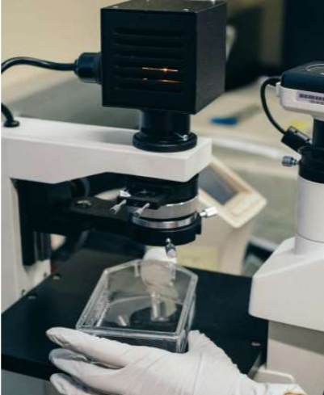
Why research data management
Provides for reproducibility of experimental and computational outcomes

Slide 13
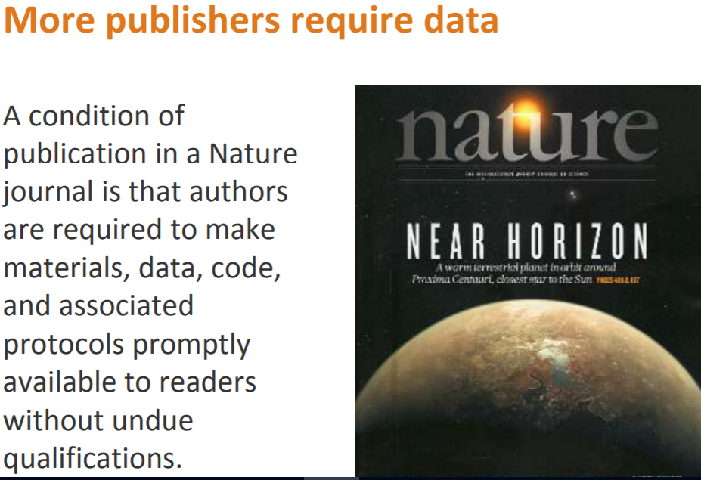
Why research data management

Slide 14
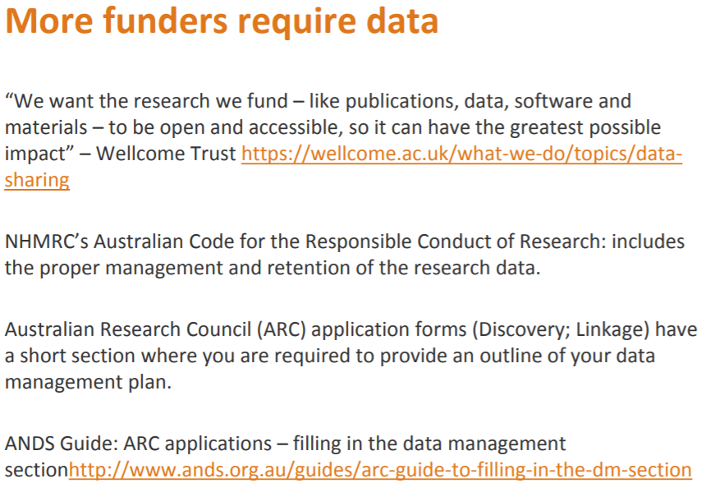
Why research data management

Slide 15
Why research data management

Slide 16
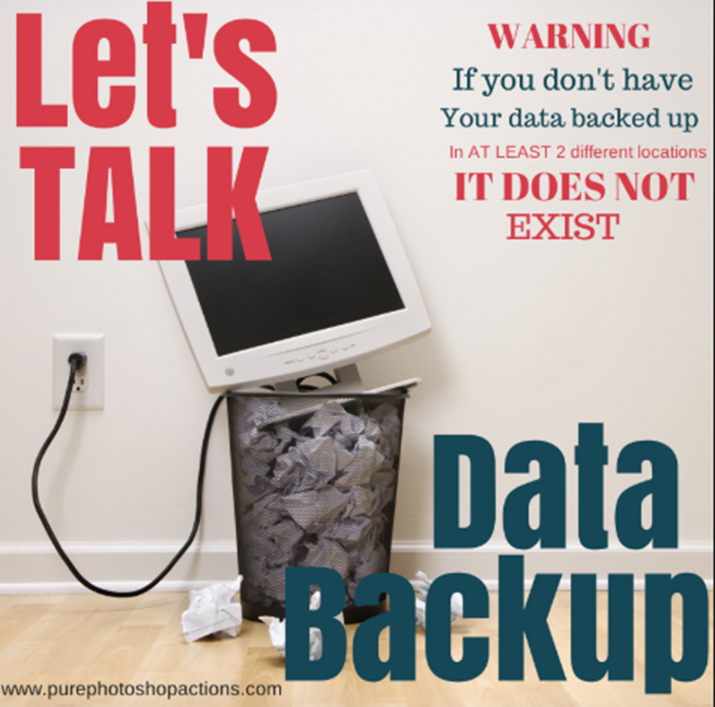
Why research data management
Minimises risk of losing your data

Slide 17
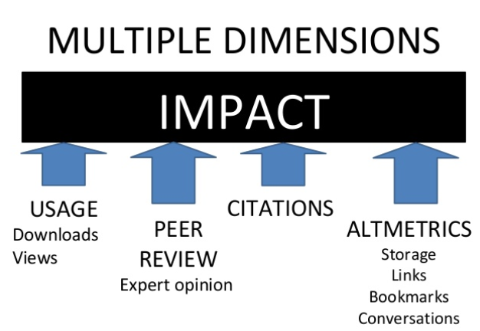
Why research data management
Research impact
Linking data and publication
Making data citable

Slide 18

Why research data management
Regulatory requirements

Slide 19


Why research data management
Controlling costs
Maximising value

Slide 20
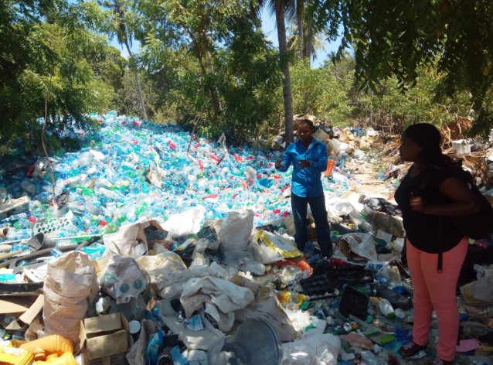

Why research data management
Enable re-use

Slide 21
In Brief…….
Any definition of research data is likely to depend on the context in which the question is asked.
Any research will require some level of data management
Good data management can increase the efficiency of your research and enable the exposure of your research outcomes through collaboration and dissemination
More publishers, funders, governments and institutions require data management and sharing
More researchers care about data sharing and are sharing their own data
Not all data can be shared. Data can be open, shared or closed.

Slide 22
Some KEY issues in data management
FAIR data principles
Data need to be:
Findable
Accessible
Interoperable
Re-usable

Slide 23

Some KEY issues in data management
Findable

Slide 24
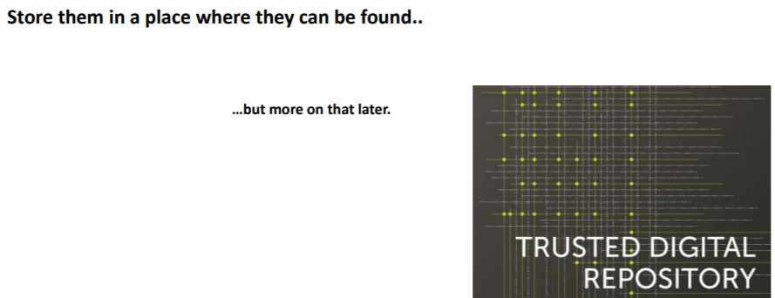
Some KEY issues in data management
Findable

Slide 25
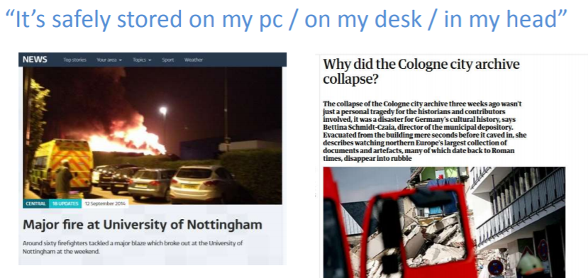
Some KEY issues in data management
Backup

Slide 26
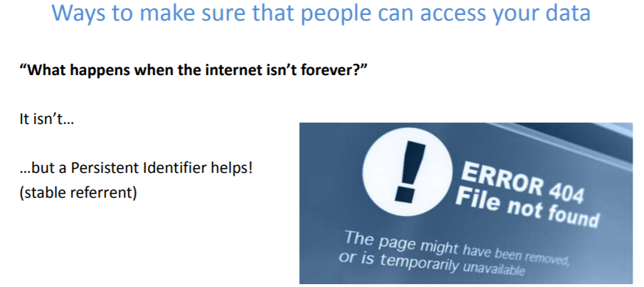
Some KEY issues in data management
Accessible

Slide 27
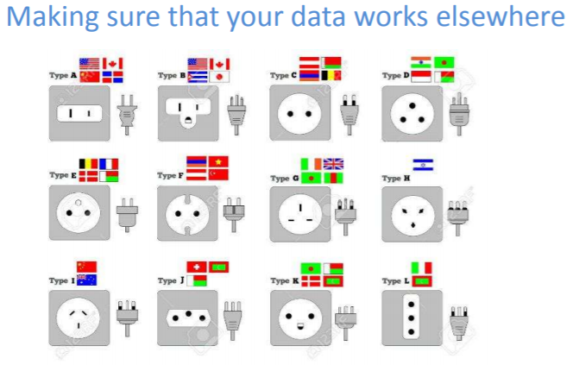
Some KEY issues in data management
Interoperable

Slide 28
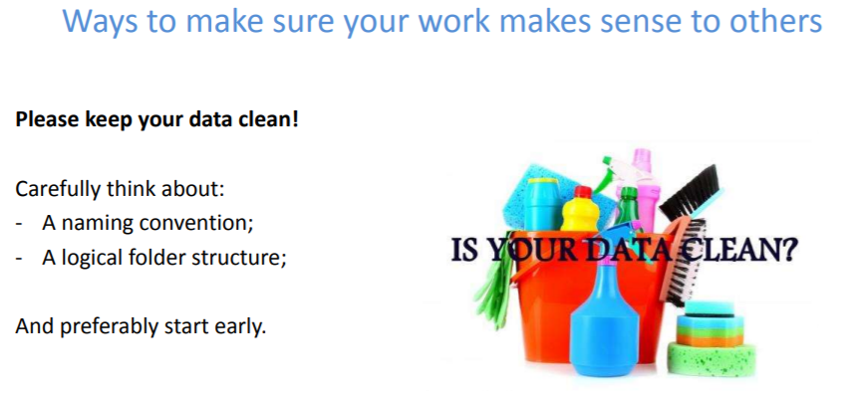
Some KEY issues in data management
Re-Usable

Slide 29
https://www.youtube.com/watch?v=N2zK3sAtr-4

Slide 30
• Open access/open science/open data

Slide 31
References: https://www.slideshare.net/AustralianNationalDataService/winter-school-in-research-data-science-research-data-management-final?qid=d7fd5eff-c08d-4c09-88da-6fc7f9026711&v=&b=&from_search=9 https://www.slideshare.net/frankuiterwaal/research-data-management-importance-good-practices-guidance?qid=d7fd5eff-c08d-4c09-88da-6fc7f9026711&v=&b=&from_search=5 https://www.slideshare.net/CSUC_info/research-data-management-csuc-activities-services?qid=d7fd5eff-c08d-4c09-88da-6fc7f9026711&v=&b=&from_search=2

Slide 32
THANK YOU

Slide 33
Acknowledgements

